Slide 1
Value Proposition Map
DMIT1006 – Business Practices

Slide 2
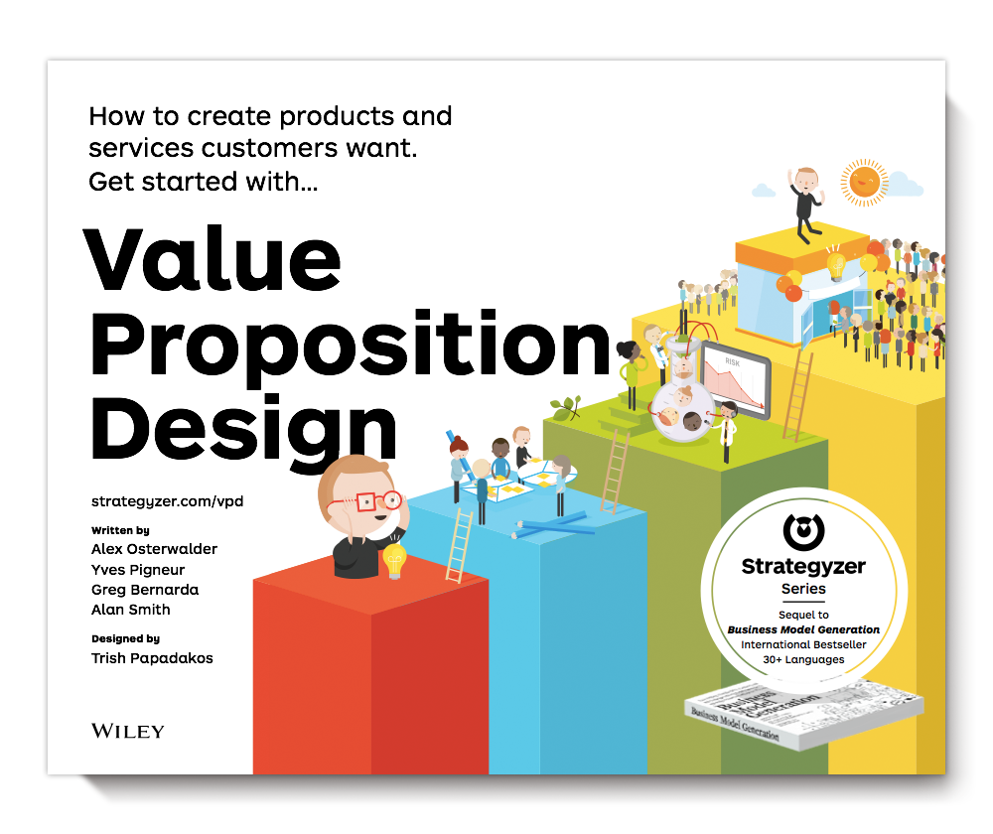
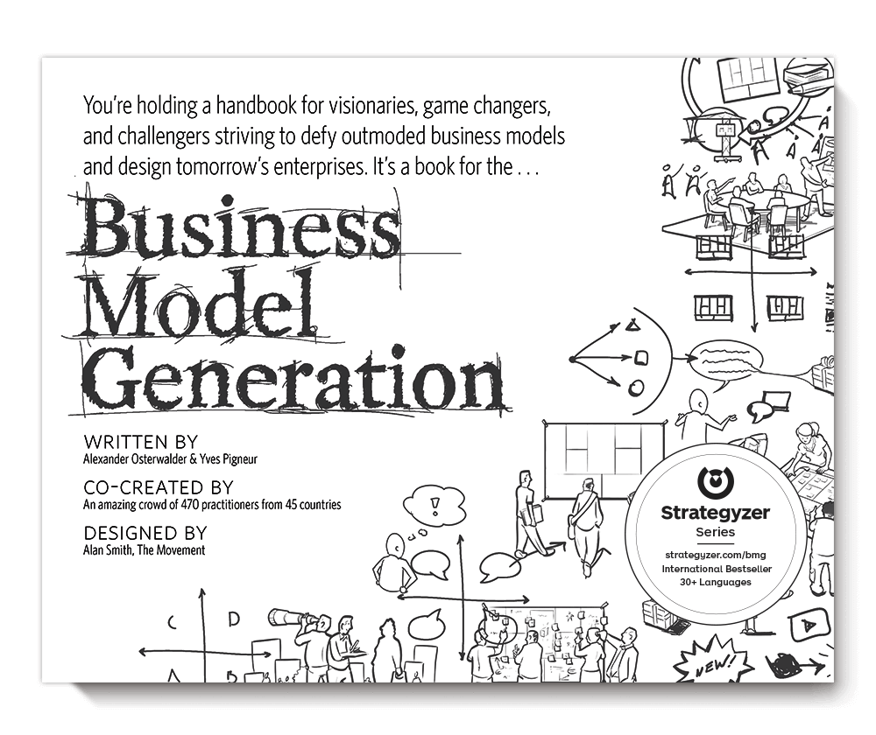
Our Primary Resources
Value Proposition Design
Business Model Generation

Slide 3
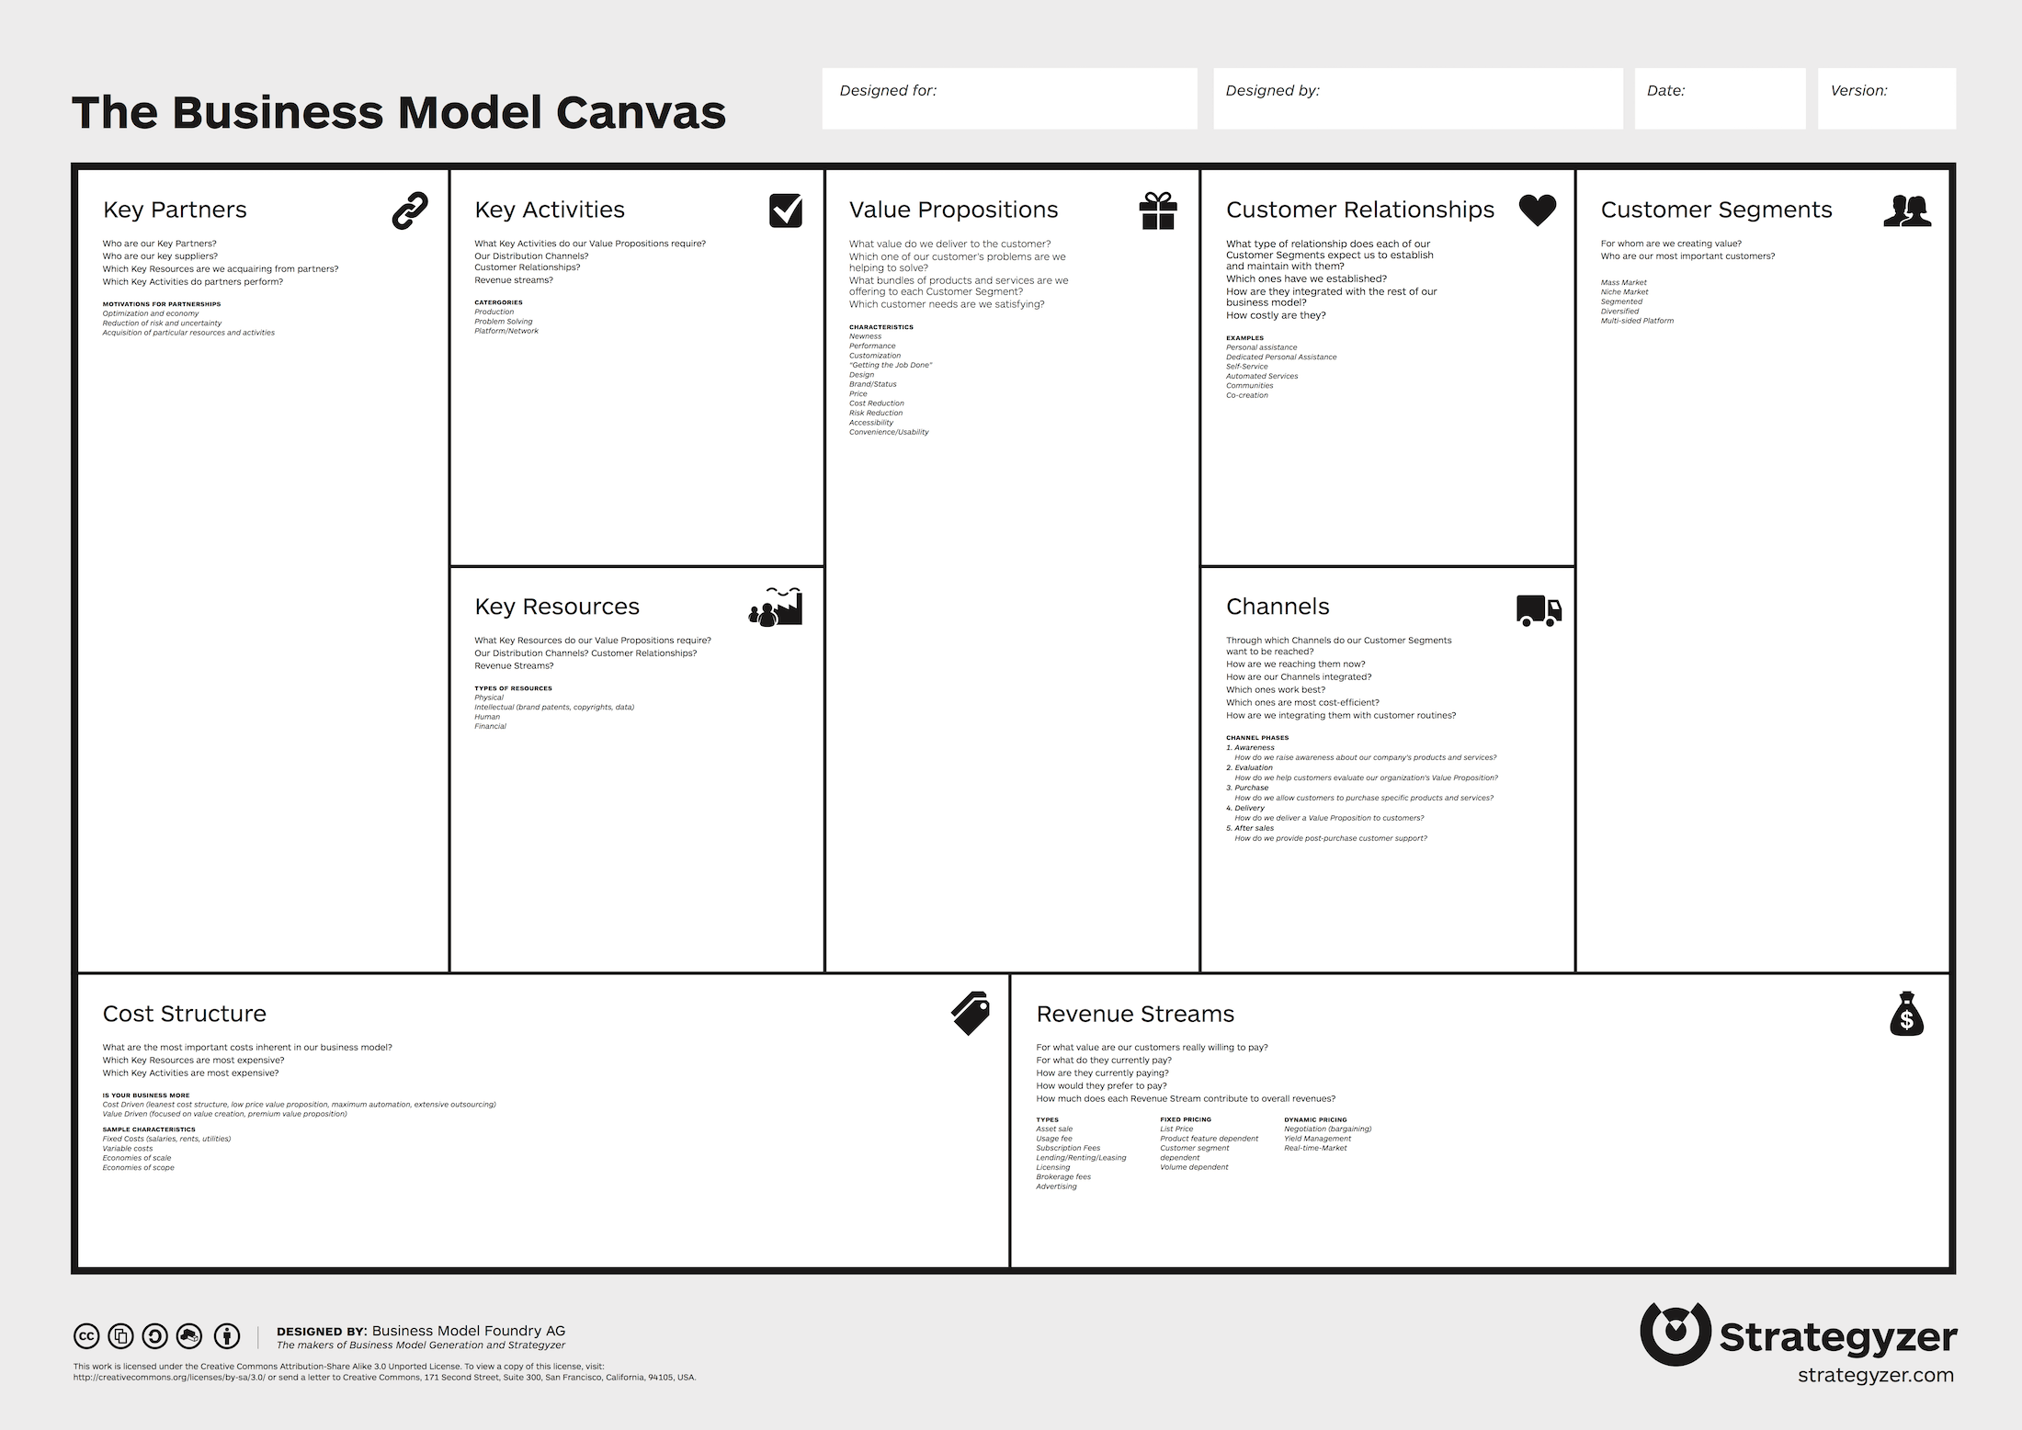
Looking ahead 🔭
Business Model Canvas
In future assignments we will discuss the entire model
As a steppingstone, we will focus on the Value Proposition and Customer Segments

Slide 4
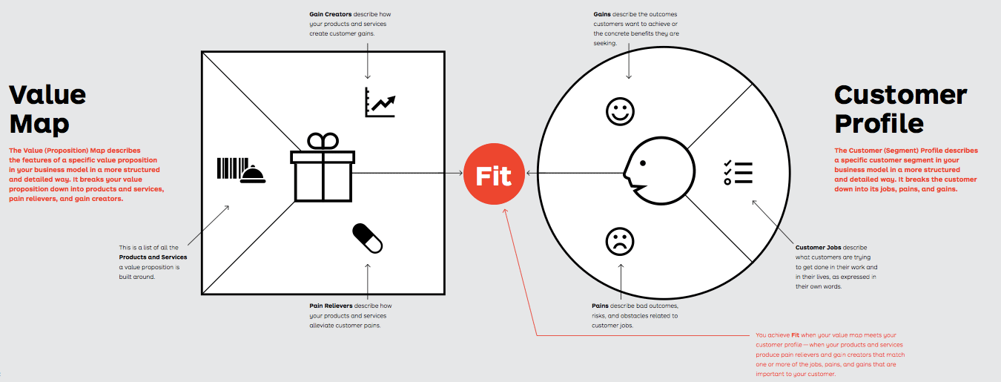
Osterwalder, & Papadakos, T. (2014). Value proposition design : how to create products and services customers want : get started with; Wiley.
Notes:
We will develop each of the concepts within this model. Students will then apply there understanding to the analysis of a Dragon’s Den pitch. It is not necessary to emphasize any details in this image.

Slide 5
Customer Profile

Slide 6
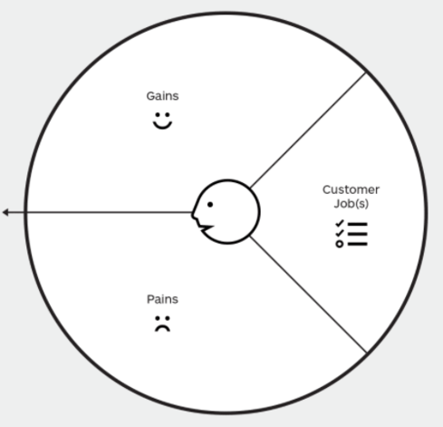
Customer Profile
The Customer (Segment) Profile describes a specific customer segment in your business model in a more structured and detailed way. It breaks the customer down into its jobs, pains, and gains.
Osterwalder, & Papadakos, T. (2014). Value proposition design : how to create products and services customers want : get started with; Wiley.

Slide 7
Customer Profile: Jobs
Customer Jobs describe what customers are trying to get done in their work and their lives, as expressed in their own words.
Osterwalder, & Papadakos, T. (2014). Value proposition design : how to create products and services customers want : get started with; Wiley.

Slide 8
Customer Profile: Jobs
Functional jobs
When your customers try to perform or complete a specific task or solve a specific problem, for example:
mow the lawn,
eat healthy as a consumer,
write a report, or
help clients as a professional.
What functional jobs (specific task or solve a specific problem) do DMIT Students need to get done in their work and lives?
Osterwalder, & Papadakos, T. (2014). Value proposition design : how to create products and services customers want : get started with; Wiley.

Slide 9
Customer Profile: Jobs
Social jobs
When your customers want to look good or gain power or status. These jobs describe how customers want to be perceived by others, for example:
look trendy as a consumer or
be perceived as competent as a professional.
What social jobs (look good or gain power or status) do DMIT Students need to get done in their work and lives?
Osterwalder, & Papadakos, T. (2014). Value proposition design : how to create products and services customers want : get started with; Wiley.

Slide 10
Customer Profile: Jobs
Personal/emotional jobs
When your customers seek a specific emotional state, such as feeling good or secure, for example:
seeking peace of mind regarding one’s investments as a consumer or
achieving the feeling of job security at one’s workplace.
What personal/emotional jobs (specific emotional state) do DMIT Students need to get done in their work and lives?
Osterwalder, & Papadakos, T. (2014). Value proposition design : how to create products and services customers want : get started with; Wiley.

Slide 11
Customer Profile: Jobs
Supporting jobs
Customers also perform supporting jobs in the context of purchasing and consuming value either as consumers or as professionals. These jobs arise from three different roles:
BUYER OF VALUE: jobs related to buying value, such as comparing offers, deciding which products to buy, standing in a checkout line, completing a purchase, or taking delivery of a product or service.
COCREATOR OF VALUE: jobs related to cocreating value with your organization, such as posting product reviews and feedback or even participating in the design of a product or service.
TRANSFERRER OF VALUE: jobs related to the end of a value proposition’s life cycle, such as canceling a subscription, disposing of a product, transferring it to others, or reselling it.
Any supporting jobs for DMIT Students?
Osterwalder, & Papadakos, T. (2014). Value proposition design : how to create products and services customers want : get started with; Wiley.

Slide 12
Customer Jobs: Trigger Questions
What is the one thing that your customer couldn’t live without accomplishing? What are the steppingstones that could help your customer achieve this key job?
What are the different contexts that your customers might be in? How do their activities and goals change depending on these different contexts?
Osterwalder, & Papadakos, T. (2014). Value proposition design : how to create products and services customers want : get started with; Wiley.

Slide 13
Customer Jobs: Trigger Questions
What does your customer need to accomplish that involves interaction with others?
What tasks are your customers trying to perform in their work or personal life? What functional problems are your customers trying to solve?
Osterwalder, & Papadakos, T. (2014). Value proposition design : how to create products and services customers want : get started with; Wiley.

Slide 14
Customer Jobs: Trigger Questions
Are there problems that you think customers have that they may not even be aware of?
What emotional needs are your customers trying to satisfy? What jobs, if completed, would give the user a sense of self-satisfaction?
Osterwalder, & Papadakos, T. (2014). Value proposition design : how to create products and services customers want : get started with; Wiley.

Slide 15
Customer Jobs: Trigger Questions
How does your customer want to be perceived by others? What can your customer do to help themselves be perceived this way?
How does your customer want to feel? What does your customer need to do to feel this way?
Track your customer’s interaction with a product or service throughout its lifespan. What supporting jobs surface throughout this life cycle? Does the user switch roles throughout this process?
Osterwalder, & Papadakos, T. (2014). Value proposition design : how to create products and services customers want : get started with; Wiley.

